Slide 1
Stock Price Predictor Using Sentiment Analysis

Slide 2
RECAP
Objective: Develop an advanced predictive model leveraging sentiment analysis to forecast stock prices.
Data Sources: Utilizes diverse data, including financial reports, news articles, and social media content.
Approach: Employs cutting-edge machine learning techniques and natural language processing to analyse market sentiments.
Phases: Structured around key phases - Data Understanding, Preparation, Modelling, Evaluation, Deployment, and
Ongoing Maintenance.
Goal: Aims to provide investors and financial analysts with accurate, real-time market insights for informed decision-making.
Innovation: Integrates traditional financial indicators with sentiment data for a more holistic view of market trends.
Outcome: Strives to enhance investment strategies by minimizing risks and maximizing returns through data-driven insights.

Slide 3
Table of contents
1
2
3
4
Project Overview
Methodology
Code Overview
Results

Slide 4



1
PROJECT OVERVIEW

Slide 5
METHODOLOGY
Data Collection
Data Preprocessing
Data cleaning and preparation for analysis.
Utilized advanced sentiment analysis techniques to gauge market sentiment.
Extract relevant features from sentiment data for model input.
Tools/library used: -Octoparse and custom scripts
Stock prices and sentiment data from financial news and social media.

Slide 6
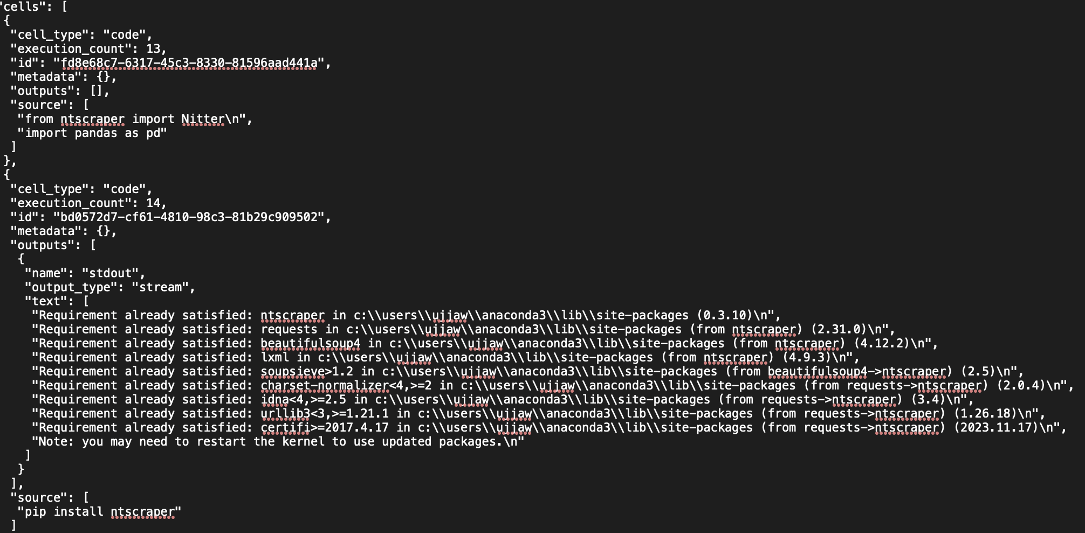
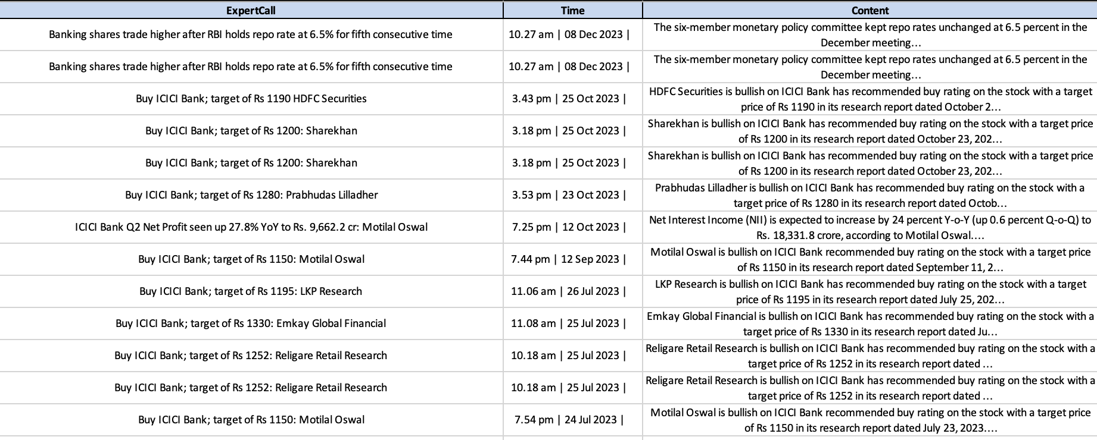
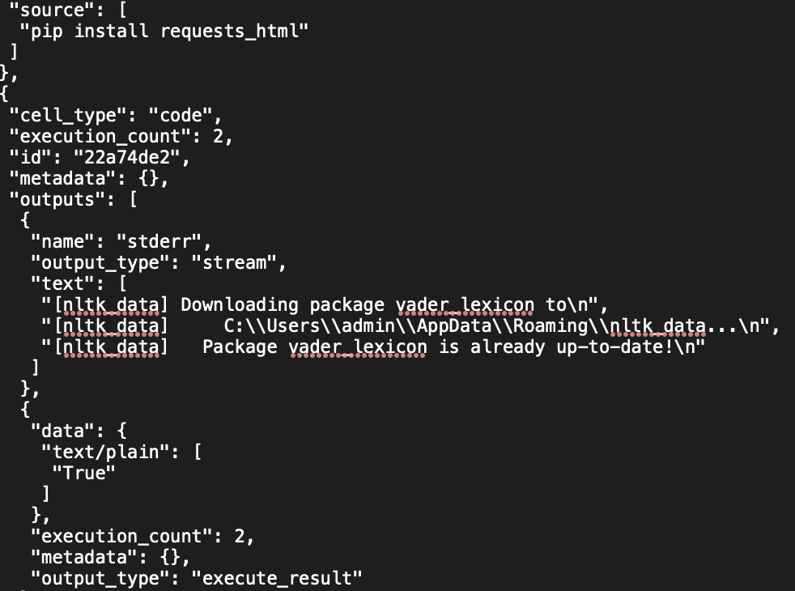
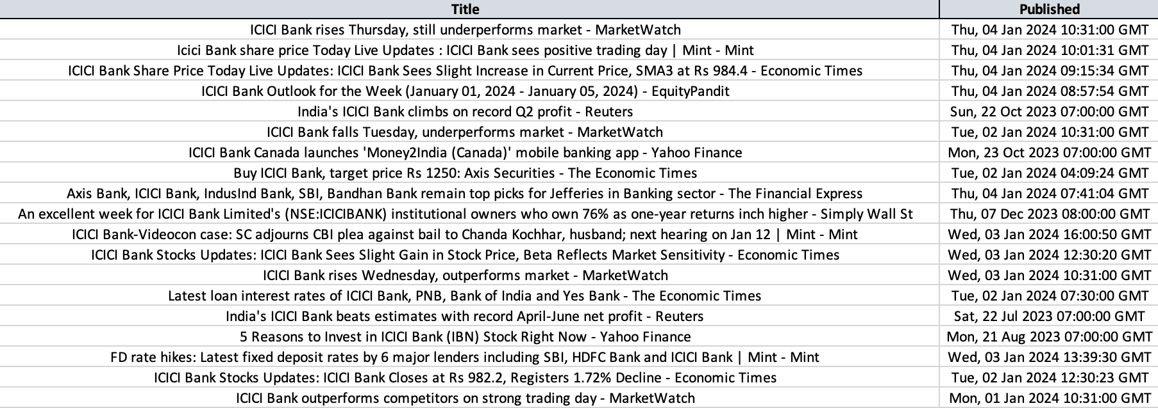
DATA COLLECTION AND PREPROCESSING
Scrapping Tweets
Scrapping using Octoparse
Scrapping IBN
Scrapping Google News

Slide 7
Code Overview
Python Script
Functionalities
Deployment
Implement a robust machine learning model (e.g., regression) for stock price prediction.
- Train the model on historical data, incorporating sentiment signals.(Streamlit, pandas)
- Summarize the primary goal of the code, emphasizing its role in Stock Price Prediction.
- Outline core functionalities, illustrating how they collectively contribute to achieving accurate predictions.
- Snapshot of the deployment structure and its components.
- Highlight key scripts, configurations, or platforms involved in the deployment process.

Slide 8
Code Overview
Data Gathering
Data Preprocessing
Sentiment Analysis
Collect historical stock prices and sentiment data for analysis.
-Retrieved historical stock prices.
- Gathered sentiment data from specified sources.
Prepared data for effective analysis and model training.
- Dealt with missing data points.
- Standardized or normalized numerical features.
- Converted textual data into a suitable format for sentiment analysis.
Analyzed sentiment in financial news articles and social media posts.
- Utilized NLP tools for sentiment analysis.
- Assigned sentiment scores to each piece of data.
Feature Engineering
Extracted relevant features for model input.
- Combined sentiment scores with traditional stock indicators.
- Created lag features to capture temporal patterns.
ML Model
- Built a robust machine learning model for stock price prediction
- Selected a suitable machine learning algorithm
- Trained the model on historical data.

Slide 9
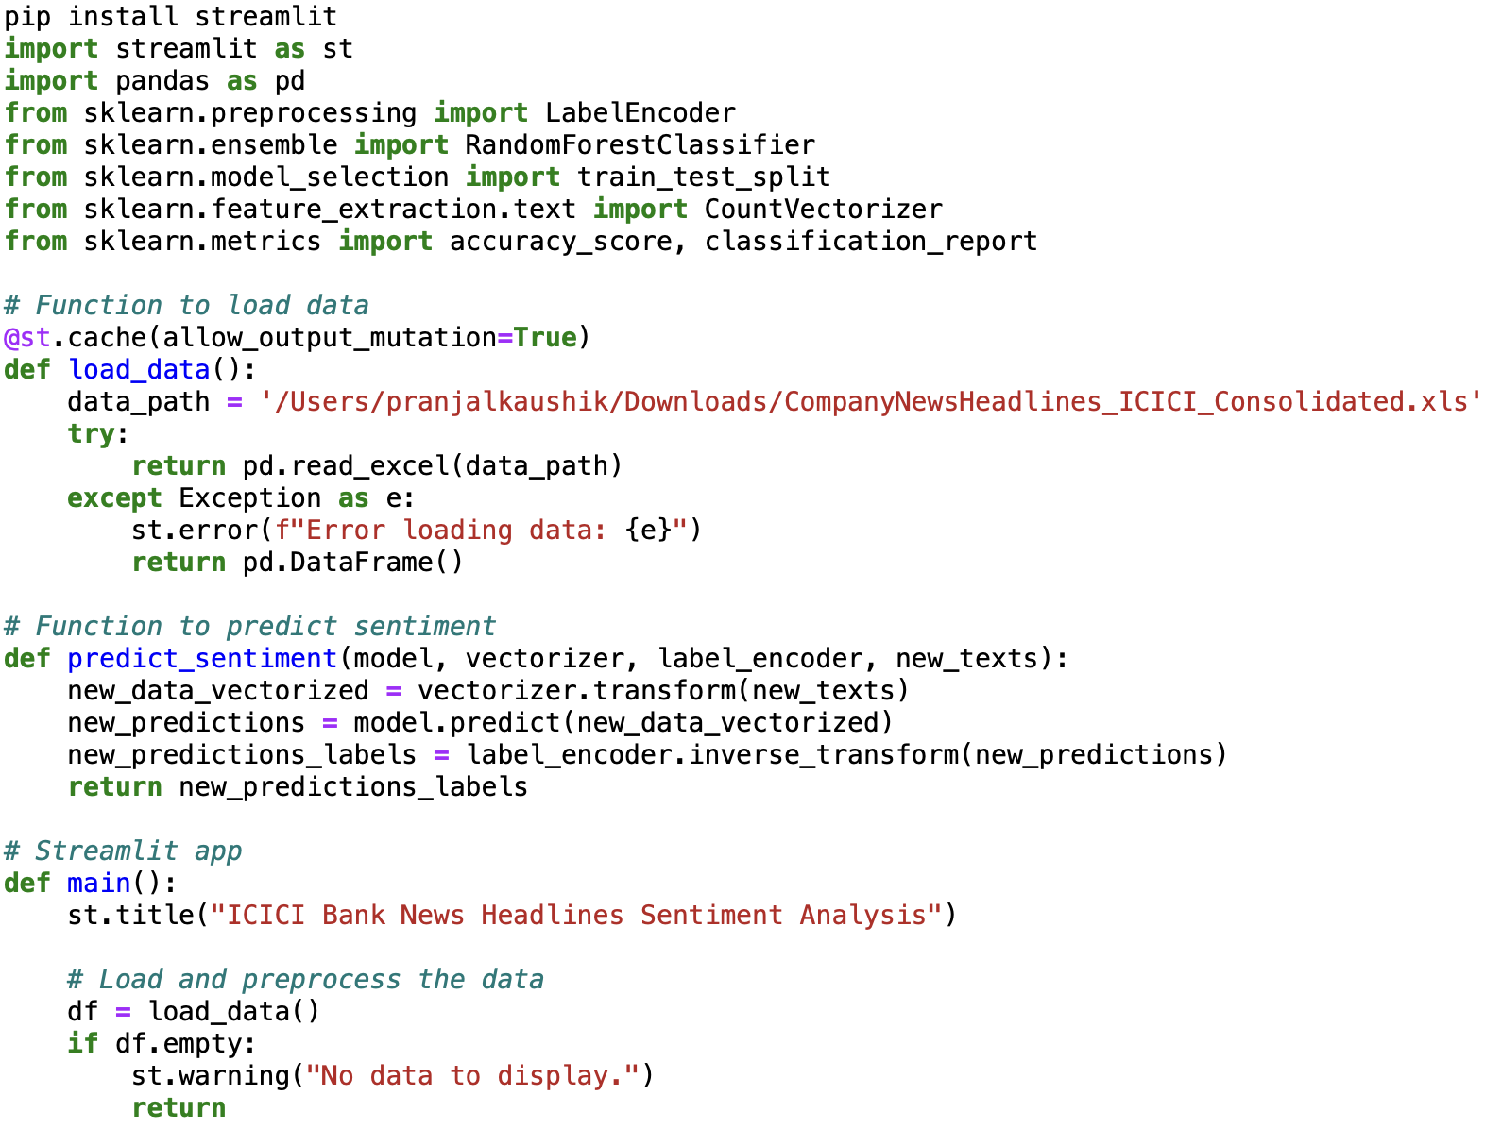
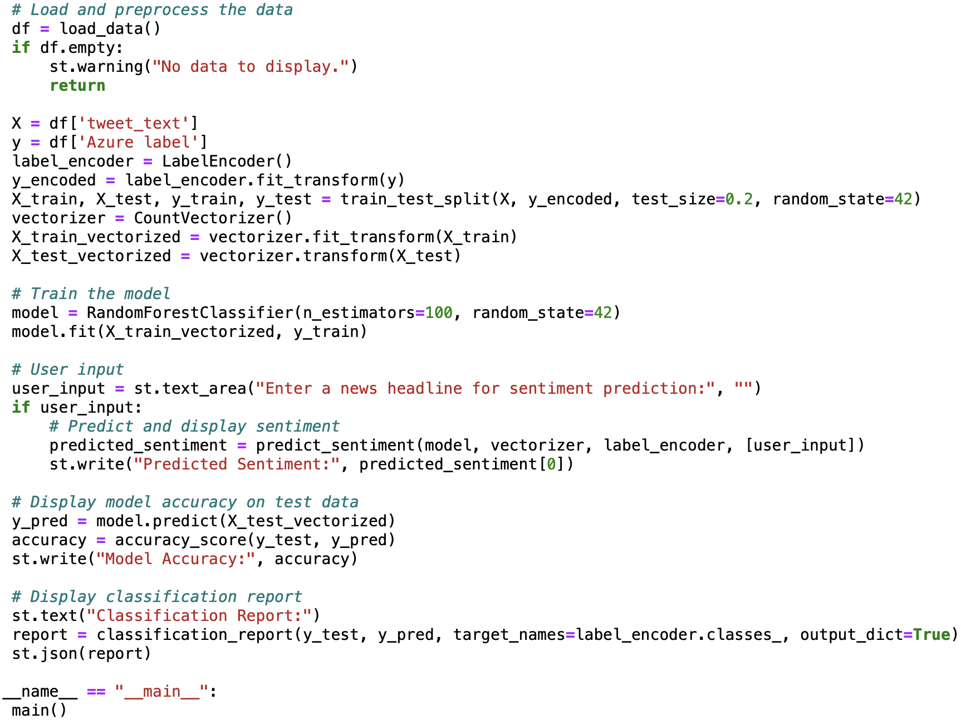
CODE SNAPSHOT

Slide 10


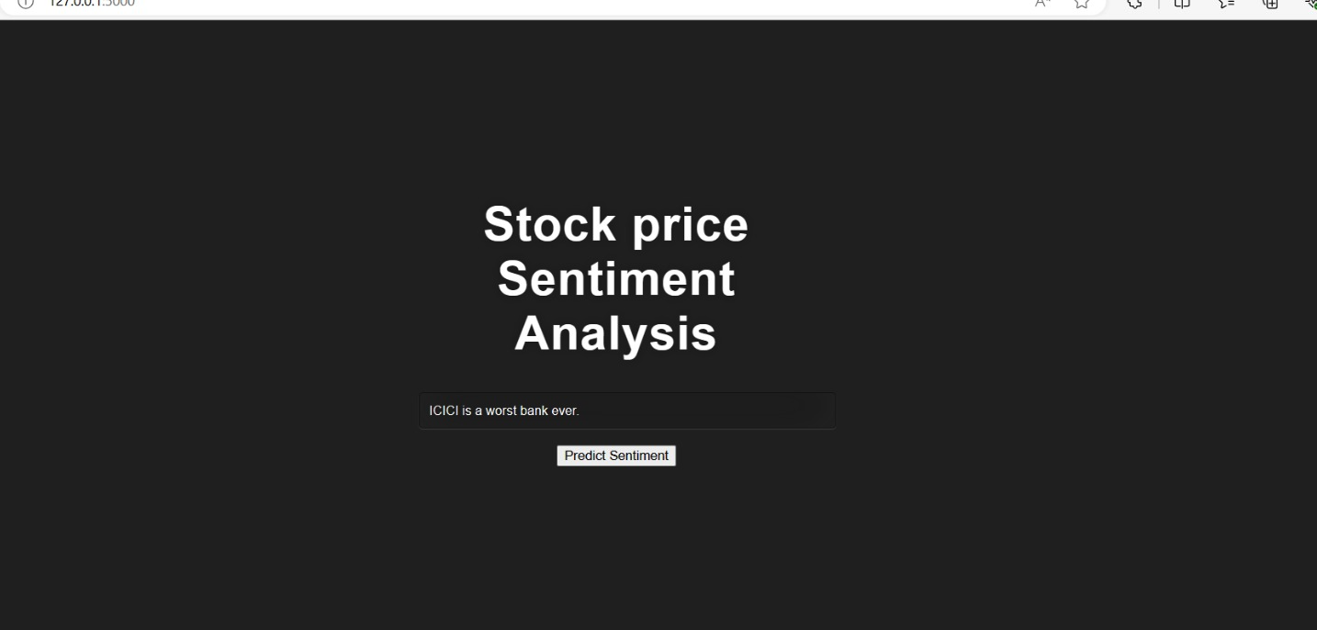
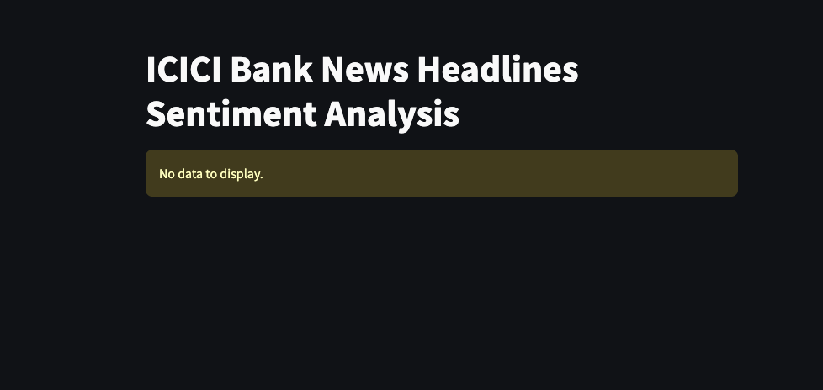
RESULT-DEPLOYMENT
We have leveraged Streamlit, an innovative app framework for Machine Learning and Data Science projects, to deploy our sentiment analysis model. This deployment transforms our Python scripts into a shareable web application, enabling interactive and user-friendly exploration of real-time sentiment analysis and stock price prediction for ICICI Bank. With its streamlined interface, users can effortlessly input new data, visualize sentiment trends, and observe corresponding stock market predictions.

Slide 11
Thank You!

